Slide 1

EAD- Cab Investment analytics
By Shuyi Yu
Intern 2024
8/11/2024

Slide 2


Slide 3
Executive Summary
XYZ is a private firm in US. Due to remarkable growth in the Cab Industry in last few years and multiple key players in the market, it is planning for an investment in Cab industry and as per their Go-to-Market(G2M) strategy they want to understand the market before taking final decision.
This presentation will be judged based on the visuals provided, the quality of the analysis and the value of the recommendations and insights.
The two primary candidate being considered for investigation are: 'Pink Cab' and 'Yellow Cab'.

Slide 4
Problem Statement
By the end of this Exploratory Data analysis the following problem statements will be answer in each slide to ultimately decide which cap business to invest on:
which company has higher customer retention rate?
which company has higher revenue growth over time?
which company has higher revenue growth over time?
What are the attributes of these customer segments?
Is there any seasonality in number of customers using the cab service?
Does revenue proportionally increase with increase in number of customers differences in both companies?
What are the top profitable five cities for each company?

Slide 5
Approach
The approach that this EDA will be utilizing is a through analysis on the comparison between 'Pink Cab' and 'Yellow Cab' based on the following data sets from 31/01/2016 to 31/12/2018. The analysis will be perform to reveal insight in seven different perspectives in respect to their customers, region, revenue, profit trends and patterns.
Cab_Data.csv – this file includes details of transaction for 2 cab companies
Customer_ID.csv – this is a mapping table that contains a unique identifier which links the customer’s demographic details
Transaction_ID.csv – this is a mapping table that contains transaction to customer mapping and payment mode
City.csv – this file contains list of US cities, their population and number of cab users
us_holiday_dates.csv - this file reveals the US holidays

Slide 6
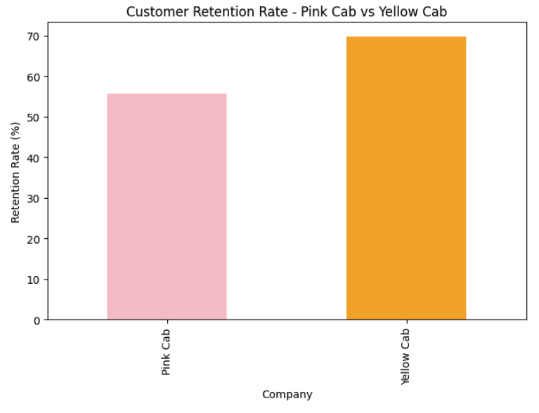
Comparison distribution on number of rides for each Cab company month 2016-2018
Hypothesis: which company has higher customer retention rate?
Yellow cap has a higher customer retention rate than pink cab. In the analysis shown, pink cap approximately have 55% customer retention rate where as yellow cap has close to 70% customer retention rate. Thus, between these two companies we can believe that customer tends to be more satisfied with yellow cab company's service.

Slide 7
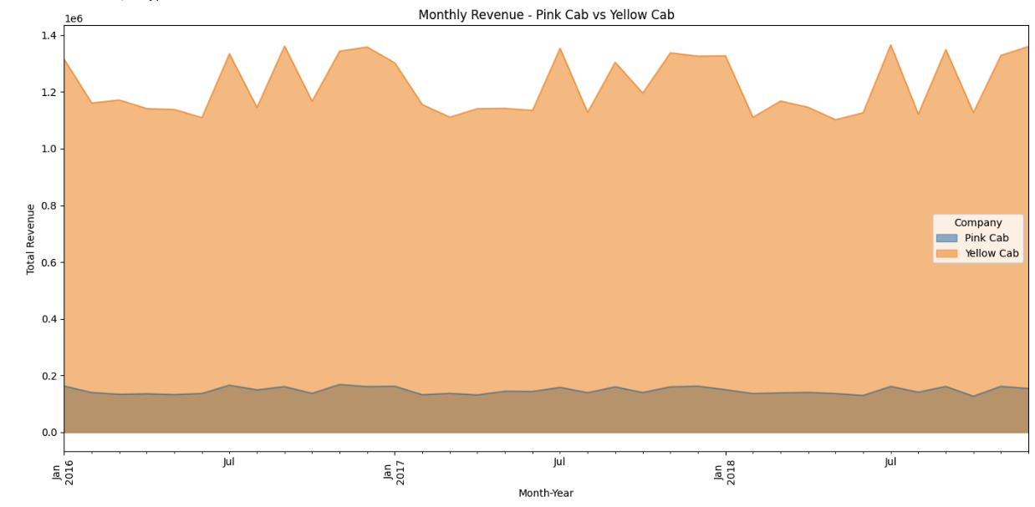
Comparison distribution on number of rides for each Cab company month 2016-2018
Hypothesis: which company has higher revenue growth over time?
Yellow cap outstands in reaching a lot higher in revenue than pink cap. In the graph, yellow cab is reaching range from 1.1M - 1.35M whereas pink cab is only reaching on average 200k a month.

Slide 8
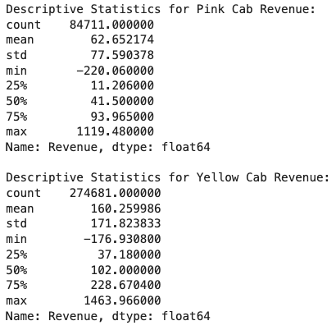
Comparison distribution on number of rides for each Cab company month 2016-2018
Hypothesis: which company has higher revenue growth over time?
Yellow Cab earns more revenue primarily due to a combination of higher revenue per ride, a greater number of rides, and potentially more profitable service offerings. This data suggests that Yellow Cab might be a stronger candidate for investment if revenue generation is a key factor in the decision-making process.
This leads to the next question, why would customer pick a cab service that's generally more expensive and and reuses their service?

Slide 9
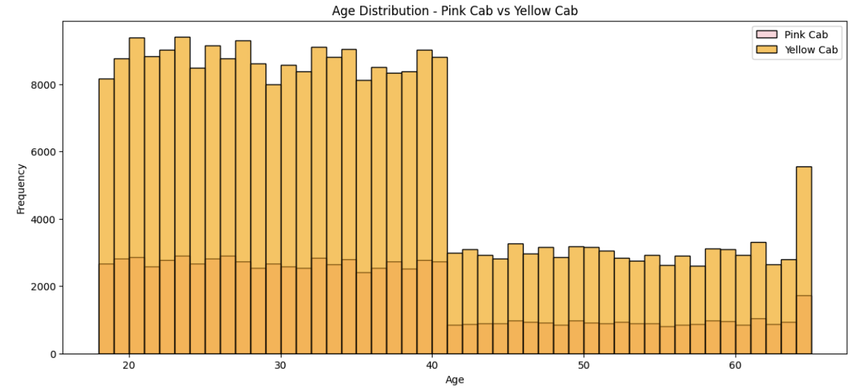
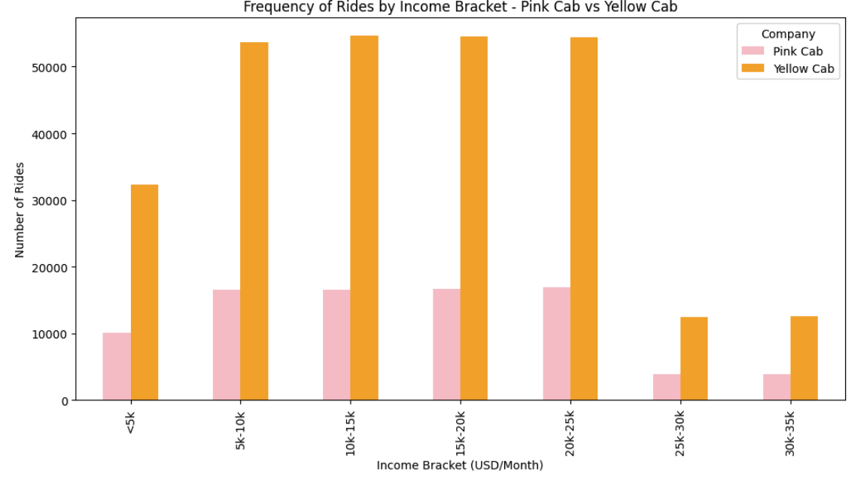
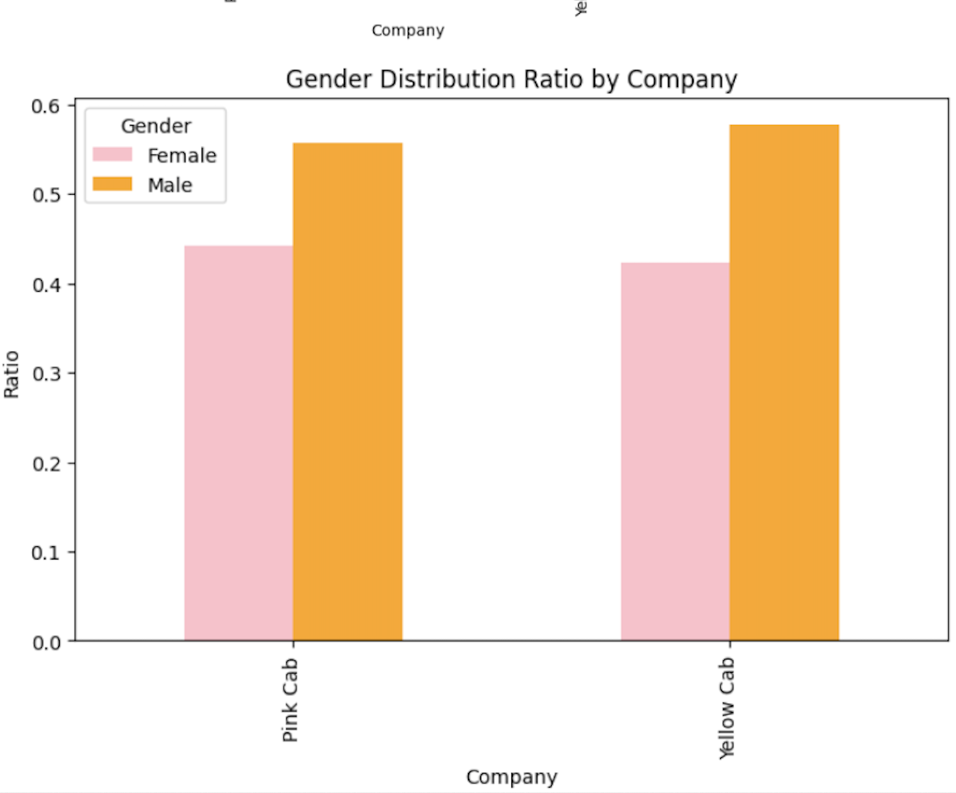

Hypothesis: What are the attributes of these customer segments?
Gender distribution ratio plot shows that both companies have a higher proportion of male customers, with Yellow Cab having a slightly higher male ratio
Age distribution for both company shows a similar pattern, with a higher concentration of customers between ages 20-40, and a noticeable decline in the number of customers over the age of 40.
Income distribution across different brackets shows a similar pattern for both companies, mostly concentrating between income 5k-25k.

Slide 10
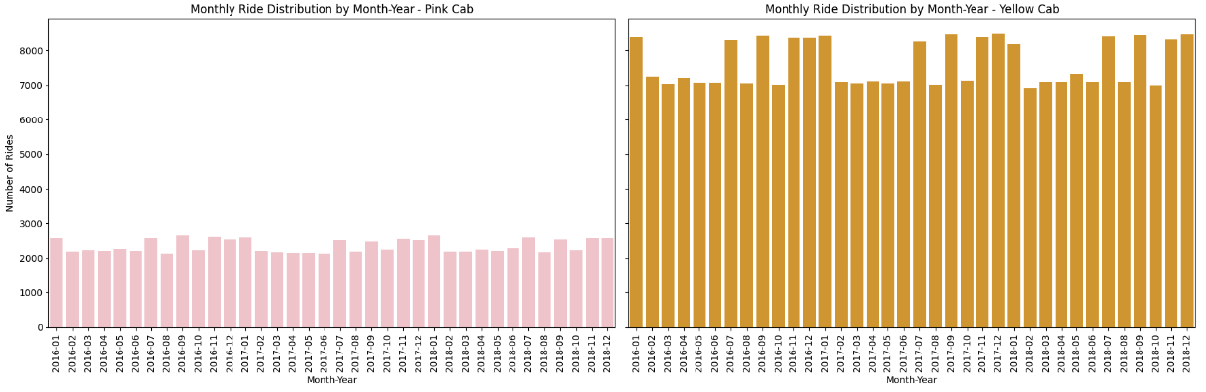
Comparison distribution on number of rides for each Cab company month 2016-2018
Hypothesis: Is there any seasonality in number of customers using the cab service?
There is pattern on an increase amount of number of rides on holiday months such as Jan, Jul, Sept, Nov, and Dec on both companies, having yellow cap higher in ration.

Slide 11
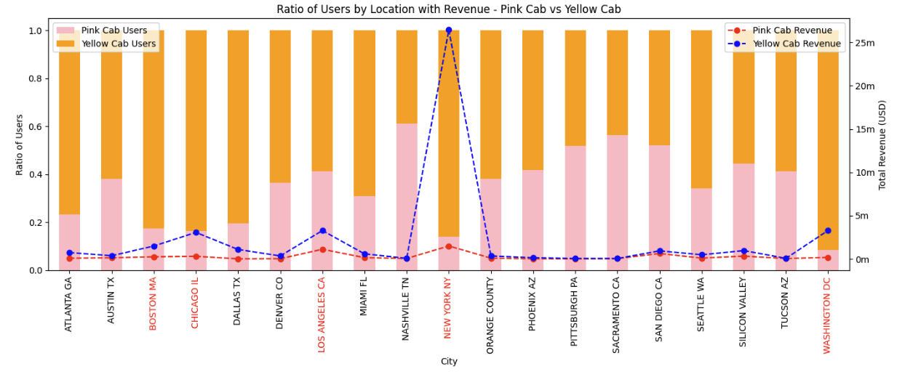
Comparison distribution on number of rides for each Cab company month 2016-2018
Hypothesis: Does revenue proportionally increase with increase in number of customers differences in both companies?
We can see in this graph that as a city has a higher ratio of users will lead to that company to have a greater increase in revenue.

Slide 12
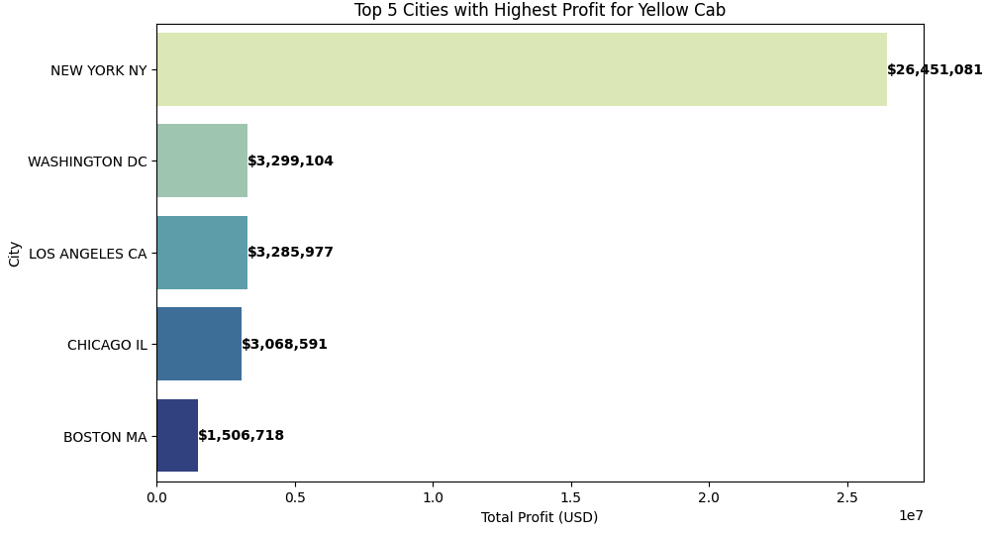
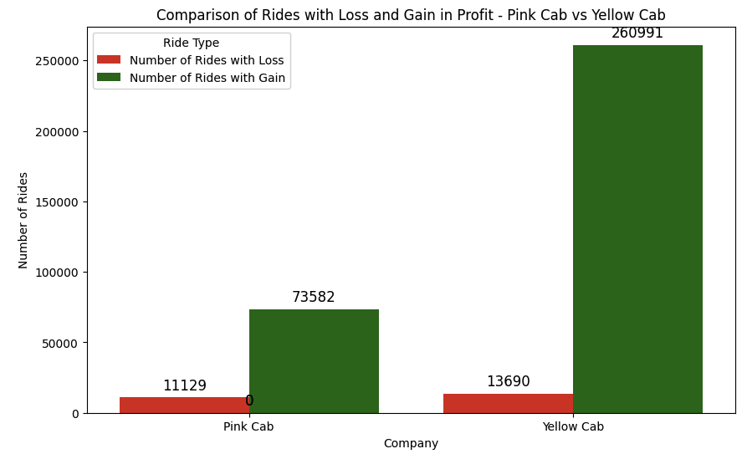
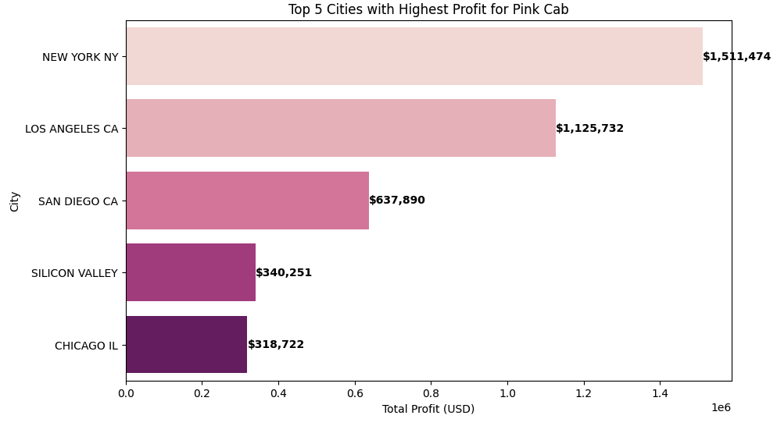
Comparison distribution on number of rides for each Cab company month 2016-2018
Hypothesis: What are the top profitable five cities for each company?
Yellow Cab outperforms Pink Cab in both profit and the number of profitable rides. In key cities New York and other, Yellow Cab’s profits are significantly higher, especially with over $26 million in New York. Yellow Cab also has a much larger number of profitable rides, highlighting its stronger market position.

Slide 13
Pink cab vs. Yellow cab investment analytics summary
Based on the data and the plotted visualizations show that Yellow Cab consistently outperforms Pink Cab in key areas:
1. Higher Revenue: Yellow Cab generates significantly more revenue, especially in major cities like New York, where it outstrips Pink Cab by a wide margin.
2. More Profitable Rides: Yellow Cab has a greater number of profitable rides, indicating more efficient operations or better pricing strategies.
3. Customer Demographics: Both companies share similar customer demographics in terms of age and income, but Yellow Cab’s larger customer base and higher ride retention suggest stronger brand loyalty.
4. Holiday Ride Surge: Both companies see an increase in rides during holiday months, but Yellow Cab captures a larger share of this surge, further boosting its revenue.
5. Profit Consistency: Yellow Cab shows higher profits across key cities, with fewer losses, reinforcing its financial stability and market dominance.
Overall, these insights strongly suggest that Yellow Cab is the better investment option.

Slide 14

Thank You
Shuyi Yu

